Slide 1



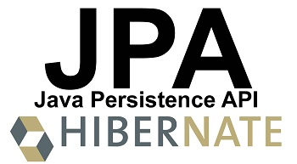
Hibernate (JPA) Code First Entity Relations
Advanced Mapping
Hibernate (JPA)
Code First
Entity Relations
SoftUni Team
Technical Trainers
Software University
http://softuni.bg

Slide 2

Table of Contents
Relational entities – Advanced Mapping strategies, annotations
OOP Inheritance – Mapping strategies
OOP Composition – Mapping strategies
Lazy Loading

Slide 3
Questions
sli.do #db-advanced

Slide 4


Inheritance

Slide 5
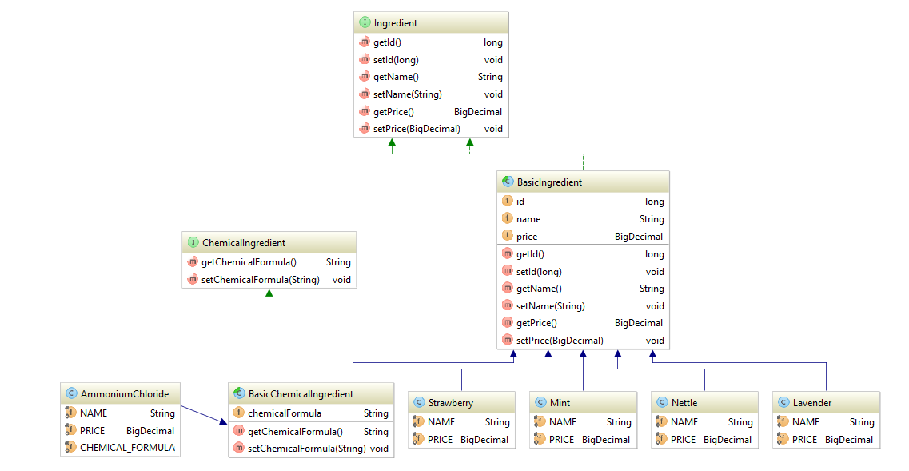
Inheritance - UML

Slide 6
Inheritance - Single Table strategy
BasicIngredient.java
@Entity
@Table(name = "ingredients")
@Inheritance(strategy = InheritanceType.SINGLE_TABLE)
@DiscriminatorColumn(name = "type", discriminatorType = DiscriminatorType.STRING)
public abstract class BasicIngredient implements Ingredient {
@Id
@GeneratedValue(strategy = GenerationType.IDENTITY)
private long id;
@Basic
private String name;
@Basic
private BigDecimal price;
protected BasicIngredient() {
}
}
Single Table
Description Column

Slide 7
Inheritance - Single Table strategy
Nettle.java
Description Value
@Entity
@DiscriminatorValue(value = "Nettle")
public class Nettle extends BasicIngredient {
}
Mint.java
Description Value
@Entity
@DiscriminatorValue(value = "Mint")
public class Mint extends BasicIngredient {
}

Slide 8
Inheritance - Single Table strategy
BasicChemicalIngredient.java
@Entity
public abstract class BasicChemicalIngredient extends BasicIngredient implements ChemicalIngredient{
@Column(name = "chemical_formula")
private String chemicalFormula;
protected BasicChemicalIngredient() {
}
}

Slide 9
Inheritance - Single Table strategy
AmmoniumChloride.java
Description Value
@Entity
@DiscriminatorValue(value = "Ammonium Chloride")
public class AmmoniumChloride extends BasicChemicalIngredient {
private static final String NAME = "Ammonium Chloride";
private static final BigDecimal PRICE = new BigDecimal("0.59");
private static final String CHEMICAL_FORMULA = "NH4Cl";
public AmmoniumChloride() {
super(NAME, PRICE, CHEMICAL_FORMULA);
}
}

Slide 10
Results - Single Table strategy
BasicChemicalIngredient.java
public class BasicChemicalIngredient {
public static void main (String[] args) {
//…
Ingredient am = new AmmoniumChloride();
Ingredient mint = new Mint();
em.persist(am);
em.persist(mint);
//…}}
ingredients
id | type | name | price | chemical_formula
1 | Ammonium Chloride | Ammonium Chloride | 0.59 | NH4Cl
2 | Mint | Mint | 3.54 | (NULL)

Slide 11
Analysis - Single Table strategy
ingredients
id | type | name | price | chemical_formula
1 | Ammonium Chloride | Ammonium Chloride | 0.59 | NH4Cl
2 | Mint | Mint | 3.54 | (NULL)
Disadvantages: requires columns to be either added or removed when the members in the hierarchy change. May contain multiple NULL values.
Advantages: Minimize joins, gives maximum performance even for classes involved in deep hierarchies.

Slide 12
Inheritance – Table Per Class strategy
BasicIngredient.java
TABLE PER CLASS
@Entity
@Inheritance(strategy = InheritanceType.TABLE_PER_CLASS)
public abstract class BasicIngredient implements Ingredient {
@Id
@GeneratedValue(strategy = GenerationType.TABLE)
private long id;
@Basic
private String name;
@Basic
private BigDecimal price;
protected BasicIngredient() {
}
}
TABLE GENERATED ID

Slide 13
Inheritance - Table Per Class strategy
Nettle.java
Table Name
@Entity
@Table(name = "nettle")
public class Nettle extends BasicIngredient {
}
Mint.java
@Entity
@Table(name = "mint")
public class Mint extends BasicIngredient {
}
Table Name

Slide 14
Inheritance - Table Per Class strategy
BasicChemicalIngredient.java
@Entity
public abstract class BasicChemicalIngredient extends BasicIngredient implements ChemicalIngredient{
@Column(name = "chemical_formula")
private String chemicalFormula;
protected BasicChemicalIngredient() {
}
}

Slide 15
Inheritance - Table Per Class strategy
AmmoniumChloride.java
Table Name
@Entity
@Table(name = "ammonium_chloride")
public class AmmoniumChloride extends BasicChemicalIngredient {
private static final String NAME = "Ammonium Chloride";
private static final BigDecimal PRICE = new BigDecimal("0.59");
private static final String CHEMICAL_FORMULA = "NH4Cl";
public AmmoniumChloride() {
super(NAME, PRICE, CHEMICAL_FORMULA);
}
}

Slide 16
Results - Table Per Class strategy
BasicChemicalIngredient.java
public class BasicChemicalIngredient {
public static void main (String[] args) {
//…
Ingredient am = new AmmoniumChloride();
Ingredient mint = new Mint();
em.persist(am);
em.persist(mint);
//…}}
ammonium_chloride
id | name | price | chemical_formula
1 | Ammonium Chloride | 0.59 | NH4Cl
mint
id | name | price
2 | Mint | 3.54

Slide 17
Analysis - Table Per Class strategy
ammonium_chloride
id | name | price | chemical_formula
1 | Ammonium Chloride | 0.59 | NH4Cl
mint
id | name | price
2 | Mint | 3.54
Disadvantages: Repeating information in each table. Changes in super class involves changes in all subclass tables. No foreign keys involved (unrelated tables)
Advantages: No NULL values. Simple style to implement inheritance mapping.

Slide 18
Inheritance – Joined strategy
BasicIngredient.java
@Entity
@Table(name = "ingredients")
@Inheritance(strategy = InheritanceType.JOINED)
public abstract class BasicIngredient implements Ingredient {
@Id
@GeneratedValue(strategy = GenerationType.IDENTITY)
private long id;
@Basic
private String name;
@Basic
private BigDecimal price;
protected BasicIngredient() {
}
}
Joined

Slide 19
Inheritance - Joined strategy
Nettle.java
@Entity
@Table(name = "nettle") @PrimaryKeyJoinColumn(name = "id")
public class Nettle extends BasicIngredient {
}
Join Column
Mint.java
@Entity
@Table(name = "mint") @PrimaryKeyJoinColumn(name = "id")
public class Mint extends BasicIngredient {
}
Join Column

Slide 20
Inheritance - Joined strategy
BasicChemicalIngredient.java
@Entity
@Table(name = "chemical_ingredient")
@PrimaryKeyJoinColumn(name = "id")
public abstract class BasicChemicalIngredient extends BasicIngredient implements ChemicalIngredient{
@Column(name = "chemical_formula")
private String chemicalFormula;
protected BasicChemicalIngredient() {
}
}
Join Column

Slide 21
Inheritance - Joined strategy
AmmoniumChloride.java
@Entity
@Table(name = "ammonium_chloride") @PrimaryKeyJoinColumn(name = "id")
public class AmmoniumChloride extends BasicChemicalIngredient {
private static final String NAME = "Ammonium Chloride";
private static final BigDecimal PRICE = new BigDecimal("0.59");
private static final String CHEMICAL_FORMULA = "NH4Cl";
public AmmoniumChloride() {
super(NAME, PRICE, CHEMICAL_FORMULA);
}
}
Join Column

Slide 22
Results - Joined strategy
BasicChemicalIngredient.java
public class BasicChemicalIngredient {
public static void main (String[] args) {
//…
Ingredient am = new AmmoniumChloride();
Ingredient mint = new Mint();
em.persist(am);
em.persist(mint);
//…}}
Also known as TABLE_PER_SUBCLASS strategy

Slide 23
Results - Joined strategy
ammonium_chloride
chemical_ingredients
id
1
id | chemical_formula
1 | NH4Cl
ingredients
mint
id | name | price
1 | Ammonium Chloride | 0.59
2 | Mint | 3.54
id
2
Disadvantages: Multiple JOINS - for deep hierarchies it may give poor performance
Advantages: No NULL values. No repeating information. Foreign keys involved. Reduced changes in schema on superclass changes

Slide 24

Relations

Slide 25
One-To-One - Unidirectional
BasicShampoo
classicLabel: ClassicLabel
+ getClassicLabel(): ClassicLabel + setClassicLabel(): void
ClassicLabel
id: int
One-to-one
shampoos
id : INT label_id: INT
One-to-one
labels
Id : INT

Slide 26
One-To-One - Unidirectional
BasicShampoo.java
@Entity
@Table(name = "shampoos")
@Inheritance(strategy = InheritanceType.SINGLE_TABLE)
public abstract class BasicShampoo implements Shampoo {
//…
@OneToOne(optional = false)
@JoinColumn(name = "label_id", referencedColumnName = "id")
private ClassicLabel label;
//…
}
One-To-One relationship
Runtime evaluation
Column name in table shampoos
Column name in table labels

Slide 27
One-To-One - Bidirectional
BasicShampoo
classicLabel: ClassicLabel
+ getClassicLabel(): ClassicLabel + setClassicLabel(): void
ClassicLabel
id: int basicShampoo: BasicShampoo
+ getBasicShampoo(): BasicShampoo + setBasicShampoo(): void
One-to-one
shampoos
id : INT label_id: INT
One-to-one
labels
Id : INT

Slide 28
One-To-One - Bidirectional
ClassicLabel.java
@Entity
@Table(name = "labels")
public class ClassicLabel implements Label{
//…
@OneToOne(mappedBy = "label", targetEntity = BasicShampoo.class)
private BasicShampoo basicShampoo;
//…
}
Field in entity BasicShampoo
Entity for the mapping

Slide 29
Many-To-One - Unidirectional
BasicShampoo
productionBatch: ProductionBatch
+ getProductionBatch(): ProductionBatch + setProductionBatch(): void
ProductionBatch
id: int
Many-to-one
shampoos
id : INT batch_id: INT
Many-to-one
batches
Id : INT

Slide 30
Many-To-One - Unidirectional
BasicShampoo.java
@Entity
@Table(name = "shampoos")
@Inheritance(strategy = InheritanceType.SINGLE_TABLE)
public abstract class BasicShampoo implements Shampoo {
//…
@ManyToOne(optional = false)
@JoinColumn(name = "batch_id", referencedColumnName = "id")
private ProductionBatch batch;
//…
}
Many-To-One relationship
Runtime evaluation
Column name in table shampoos
Column name in table labels

Slide 31
One-To-Many - Bidirectional
BasicShampoo
productionBatch: ProductionBatch
+ getProductionBatch(): ProductionBatch + setProductionBatch(): void
ProductionBatch
id: int Shampoos: Set<BasicShampoo>
+ getBasicShampoos(): Set<BasicShampoo> + setBasicShampoos(): void
many-to-One
shampoos
id : INT batch_id: INT
many-to-One
batches
Id : INT

Slide 32
One-To-Many - Bidirectional
ProductionBatch.java
@Entity
@Table(name = "batches")
public class ProductionBatch implements Batch {
//…
@OneToMany(mappedBy = "batch", targetEntity = BasicShampoo.class,
fetch = FetchType.LAZY, cascade = CascadeType.ALL)
private Set<Shampoo> shampoos;
//…
}
Field in entity BasicShampoo
Entity for the mapping
Fetching type
Cascade type

Slide 33
Many-To-Many - Unidirectional
BasicShampoo
ingredients: Set<BasicIngredient>
+ getBasicIngredients(): Set<BasicIngredient> + setBasicIngredients(): void
BasicIngredient
id: int
Many-to-Many
shampoos
id : INT
Many-to-Many
ingredients
Id : INT
One-to-Many
One-to-Many
shampoos_ingredients
shampoo_id : INT ingredient_id: INT

Slide 34
Many-To-Many - Unidirectional
BasicShampoo.java
@Entity
@Table(name = "shampoos")
@Inheritance(strategy = InheritanceType.SINGLE_TABLE)
public abstract class BasicShampoo implements Shampoo {
//…
@ManyToMany
@JoinTable(name = "shampoos_ingredients",
joinColumns = @JoinColumn(name = "shampoo_id", referencedColumnName = "id"),
inverseJoinColumns = @JoinColumn(name = "ingredient_id", referencedColumnName = "id"))
private Set<BasicIngredient> ingredients;//…
}
Many-To-Many relationship
Mapping table
Column in shampoos
Column in mapping table
Column in ingredients
Column in mapping table

Slide 35
Many-To-Many - Bidirectional
BasicShampoo
ingredients: Set<BasicIngredient>
+ getBasicIngredients(): Set<BasicIngredient> + setBasicIngredients(): void
BasicIngredient
id: int shampoos: Set<BasicShampoo>
+ getBasicShampoos(): Set<BasicShampoo> + setBasicShampoos(): void
Many-to-Many
shampoos
id : INT
Many-to-Many
ingredients
Id : INT
One-to-Many
One-to-Many
shampoos_ingredients
shampoo_id : INT ingredient_id: INT

Slide 36
Many-To-Many - Bidirectional
BasicIngredient.java
@Entity
@Table(name = "ingredients")
@Inheritance(strategy = InheritanceType.SINGLE_TABLE)
@DiscriminatorColumn(name = "type", discriminatorType = DiscriminatorType.STRING)
public abstract class BasicIngredient implements Ingredient {
//…
@ManyToMany(mappedBy = "ingredients", targetEntity = BasicShampoo.class)
private Set<BasicShampoo> shampoos;
//…
}
Field in entity BasicShampoo
Entity for the mapping

Slide 37
Lazy Loading - Fetch Types
Lazy Fetching – populates the data when a getter is called. It is the default value. Must have opened session to load lazily! Unless hibernate.enable_lazy_load_no_trans=true
Eager Fetching – populates the data when the object is created.
// The object is retieved from the database. It will have only id and batchDate populated with data
ProductionBatch productionBatch = batchService.find((long) 1);
//When the getter is called then the collection is populated with data if the transaction is open
productionBatch.getShampoos();
// The object is retieved from the database. It will have id, batchDate and shampoo collection
// populated with data
ProductionBatch productionBatch = batchService.find((long) 1);

Slide 38
Cascade
CascadeType.PERSIST: means that save() or persist() operations cascade to related entities.
CascadeType.MERGE: means that related entities are merged into managed state when the owning entity is merged.
CascadeType.REFRESH: does the same thing for the refresh() operation.
CascadeType.REMOVE: removes all related entities association with this setting when the owning entity is deleted.
CascadeType.DETACH: detaches all related entities if a “manual detach” occurs.
CascadeType.ALL: is shorthand for all of the above cascade operations.

Slide 39

Summary
Relational entities
Mapping strategies
Lazy Loading

Slide 40







Hibernate (JPA) Code First Entity Relations
https://softuni.bg/courses/databases-advanced-hibernate

Slide 41
License
This course (slides, examples, demos, videos, homework, etc.) is licensed under the "Creative Commons Attribution-NonCommercial-ShareAlike 4.0 International" license
Attribution: this work may contain portions from
"Databases" course by Telerik Academy under CC-BY-NC-SA license

Slide 42





Free Trainings @ Software University
Software University Foundation – softuni.org
Software University – High-Quality Education, Profession and Job for Software Developers
softuni.bg
Software University @ Facebook
facebook.com/SoftwareUniversity
Software University Forums
forum.softuni.bg

